Slide 1


Anime User Recommendation
&
Rating Prediction
INSY 695 Advanced Topics in Info Syst
Group 6

Slide 2















Team 6
Finn Dong
Lead Data Scientist
yfn881988
Beiqi Zhou
PM & Data Analyst
BeiqiZh
Di Gao
Lead Data Analyst
DGao25
Fandi Yi
YuanKai Ma
Lead Data Engineer
Business Analyst & Modeller
Bubbletea98
ykma2887
Git Team: Fancy Recommender,
Repo: Anime-Rating-Prediction-and-Recommendation

Slide 3

Context & Hypothesis
Industry & Company
Opportunities & Challenges
Objectives & Benefits
Hypothesis

Slide 4


Introducing the Industry & Company
Definition:
Anime: Hand-drawn and computer animation originating from Japan
Refers specifically to animation produced in Japan, or to its common style
Industry:
A consecutively expanding industry, worth $USD 24.08 billion in 2019
Well-established markets throughout the world (Japan, China, NA, EU, etc.)
Company
MyAnimeList:
Online rating website https://myanimelist.net/
Founded in 2006, US company, privately hold

Slide 5

Opportunities and Challenges
Opportunities:
Foreign investors
Growing international market
People staying home because of the current pandemic
Challenges:
Foreign competitors
Cultural diversities
Large number of choices – sometimes difficult to decide what to watch
As such, Myanimelist need to leverage their current technology to stay competitive

Slide 6

Objectives and Benefits
Use Case/Problem Statement:
Helps MyAnimeList to attract more users to their website and increase their users’ satisfaction level
Objectives/Benefits:
Increase user satisfaction level & site traffic
Prediction on anime ratings help the website better understand the preference of users
Recommendation system help users find animes of their interests faster, hence generate higher income for content providers
Increase advertising revenues
Proposed Solution:
Build a predictive model to predict user ratings on animes
Build a recommendation system that filters and recommends animes to users based on (predicted) ratings and similarities of animes

Slide 7
Hypothesis
Things to be predicted:
User Ratings for a specific anime
Possible animes that users might be interested in
Actions to be taken:
Build a prediction and a recommendation system to predict user ratings and possible animes
Possible outcome:
The percentage error is less than 20% in prediction of user ratings
A list of possible animes to recommend for users
Hypothesis testing strategy:
Confidence interval
p-values
MSE/MAPE

Slide 8
Data
PART 1
Data Acquisition
PART 3
Data Preprocessing
PART 2
Data Exploration

Slide 9

Data - Acquisition
Data Sources: https://www.kaggle.com/CooperUnion/anime-recommendations-database
Data Acquisition: The data is taken from Kaggle. It contains 73,516 users rating on 12,294 anime.
The anime dataset has shape (12294, 7)
The user rating dataset has shape (7813737, 3)
Merging: the 2 datasets on anime_id, we get a dataset of (7813737, 9)
Sample a subset of (781482, 9)

Slide 10
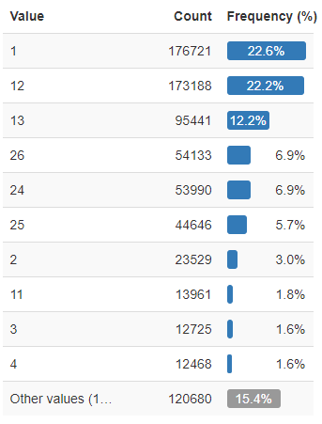
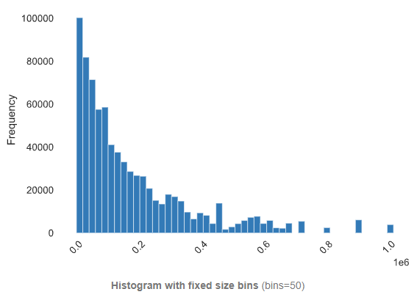
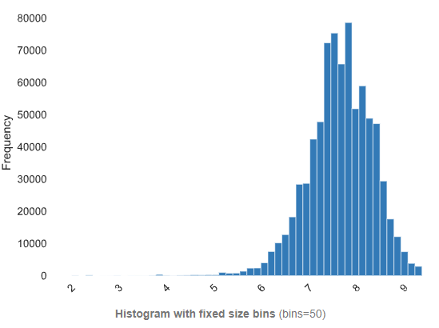
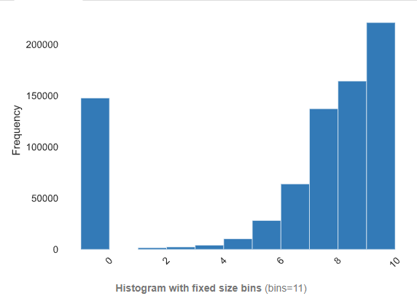
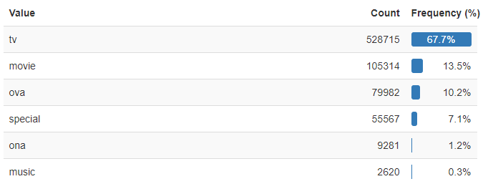
Data – Exploration & Preparation
Episode
Members
Anime Rating
User rating
Type
Drop user rating = -1
Hot encode
Notes:
The number of community members that are in this anime

Slide 11

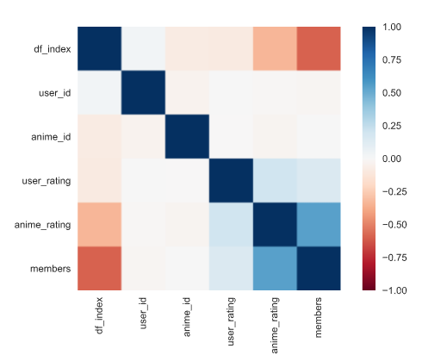
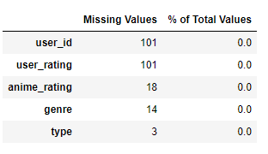
Data - Exploration & Preparation
Correlation
Drop rows
Missing Values
Fill with mean
Fill with mean
Fill with as others
Fill with as others

Slide 12
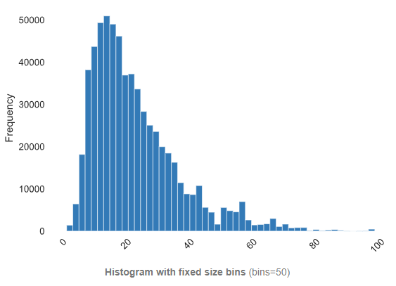
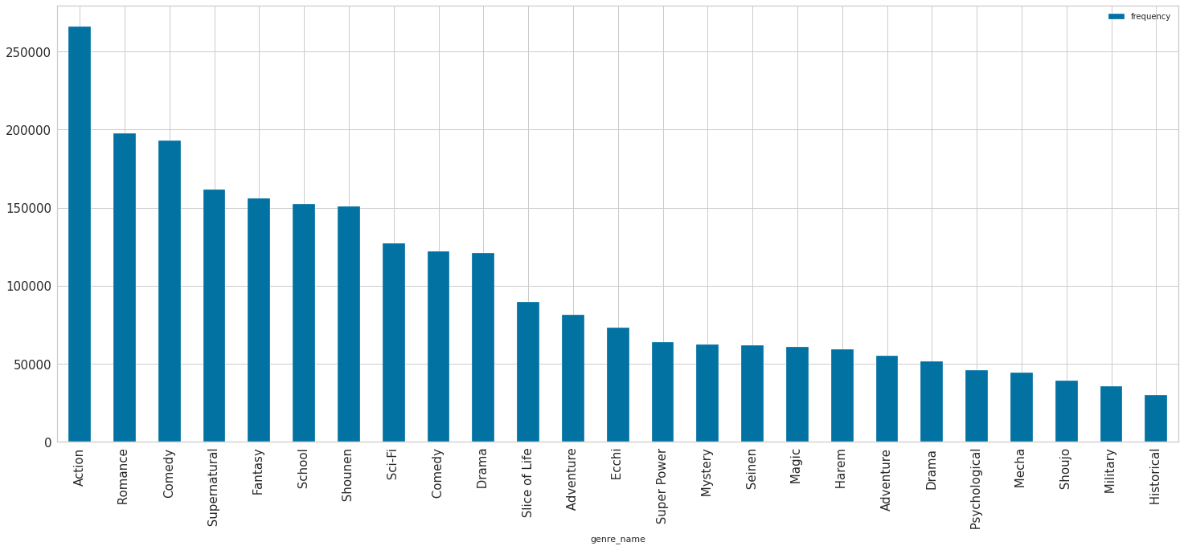
Data - Exploration & Preparation
Derived anime name length
Genre has 82 unique value. We will hot encode the top 25 most frequent genre and cluster the rest as “other_genre”

Slide 13
Model - User Rating Prediction
PART 1
Model
PART 3
Explainability of result
PART 2
Results

Slide 14

Model – User Rating Prediction
Type of Model:
Supervised Learning
Regression, predict user rating (1-10)
Modelling:
Train/test split, cross validation & K-fold
Standardize the data
Trained: linear regression, Decision tree, random forest, LightGBM, XGBoost, AdaBoost, CatBoost, multi layer perceptron, GaussianNB, KNN
Fine-Tuning
Compute MSE & RMSE
Feature Selection

Slide 15

Algorithms | MSE | RMS
Baseline Model | 2.4526 | 1.5661
Linear Regression | 2.0349
Random Forest | 2.0866 | 1.4445
Decision Tree | 2.1976
LightGBM | 2.0333 | 1.4259
XGBoost | 2.0741
AdaBoost | 2.1365
CatBoost | 2.0860
Multi-Layer Perceptron | 2.0831 | 1.4433
GaussianNB | 4.5078
KNN | 2.4526
Results
Baseline Model has MSE of 2.4526
LightGBM has the smallest out-of-sample MSE of 2.0333 and MAPE of 17.58
Top 5 algorithms: LightGBM, Linear Regression, XGBoost, Multi-Layer Perceptron, Random Forest

Slide 16
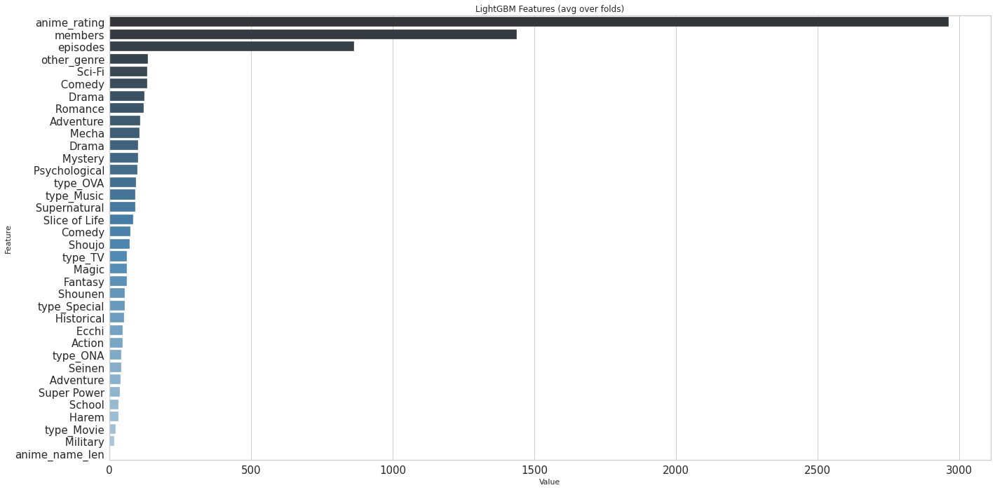
Explain the Results
Top 3 features: anime rating, members, episodes
Top 5 genres: Sci-Fi, comedy, drama, romance, adventure
Higher the anime rating, the higher the chance that user will also gives a higher rating
Users that are in a higher number of anime community are more likely to gives higher score
Higher the episode, higher the rating
Notes:
We encourage the website to have more high quality anime and will also have more members and increase user interation and satisfaction

Slide 17
Model – Recommendation System
PART 1
Categories
PART 3
Results
PART 2
Algorithms

Slide 18




Recommendation System - Categories
KNN
Correlation
K-Means
Type of system
Algorithms of system
Results of system
Notes:
Type of Sys
The recommendation system can be divided into two categories. They are content based system and collaborative based system
Firstly, The content-based filtering is based on the data provided for the product, provide the recommendation based on the similarity between items
As for collaborative, It provides recommendation based on users’ behavior and similar decision made by other users.
Our recommendation system apply collaborative filtering method, and we will introduce our three different types models in detailed.
Algorithms
We build an unsupervised KNN model which apply cosine similarity to provide the recommendation. As the graph shown on the right side, the more similar the two items are, the cosine value will more approach to 1
In the k-means model, we conduct PCA for feature selection and then used Elbow score to select the seven optimal clusters. final 10 recommendations will be pulled from the cluster based on target Anime rating upwards similarity
In the correlation model, we used Pearson R score to select the most related anime.
Results
Due to the difference of algorithms, Three results are not completely same with each other. It’s very subjective to decide which one is better. We found a python library called “surprise” which use to evaluate the performance of recommendation system with different algorithm. In the later stage, we will dive deeper into this part to continue improve our recommend system and select one as our favorite.
Evaluation
In our research, we find a python library call “surprise” which build to evaluate recommendation system. The package allow us to use RMSE(Root Mean Square Error) and MAE (mean average error) to evaluate the recommendation system

Slide 19



Recommendation System - Categories
Content-Based Filtering:
Base on the description. or data provided for that product.
Find the similarity between products based on its context or description.
Collaborative Filtering:
Base on user’s past behaviors and similar decisions made by other users
Predict items that the user may have an interest in.
Notes:
The recommendation system can be divided into two categories. They are content based system and collaborative based system
Firstly, The content-based filtering is based on the data provided for the product, provide the recommendation based on the similarity between items
As for collaborative, It provides recommendation based on users’ behavior and similar decision made by other users.
Our recommendation system apply collaborative filtering method, and we will introduce our three different types models in detailed.

Slide 20

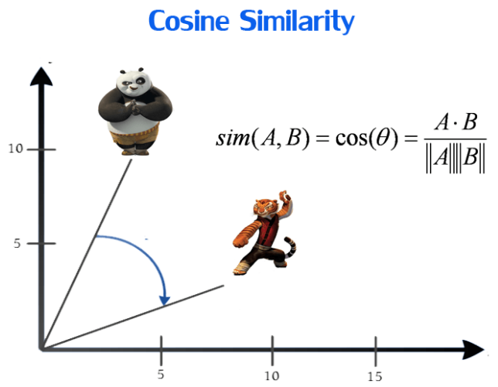
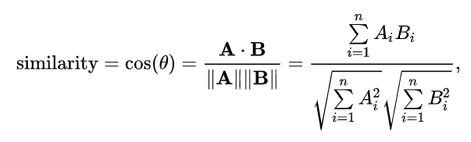

KNN based recommendation System
Metrics: Cosine Similarity
We Apply Cosine Similarity to Calculate the similarity between the anime and recommended anime. (0 to 1)
Notes:
We build an unsupervised KNN model which apply cosine similarity to provide the recommendation. As the graph shown on the right side, the more similar the two items are, the cosine value will more approach to 1

Slide 21

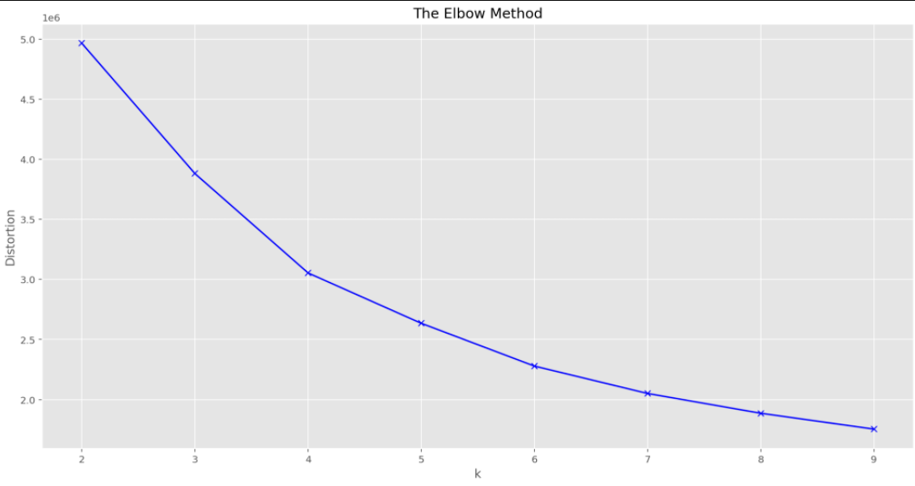
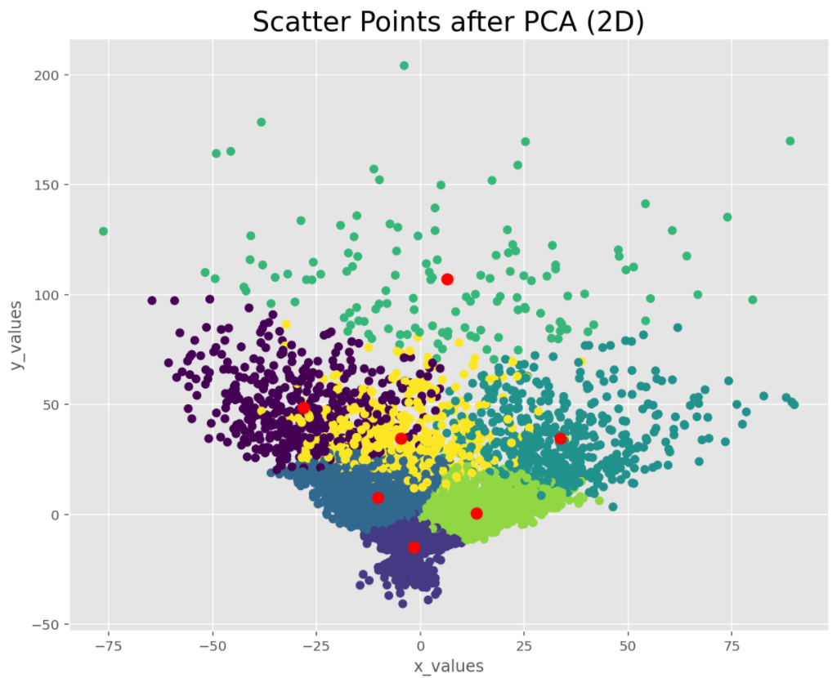
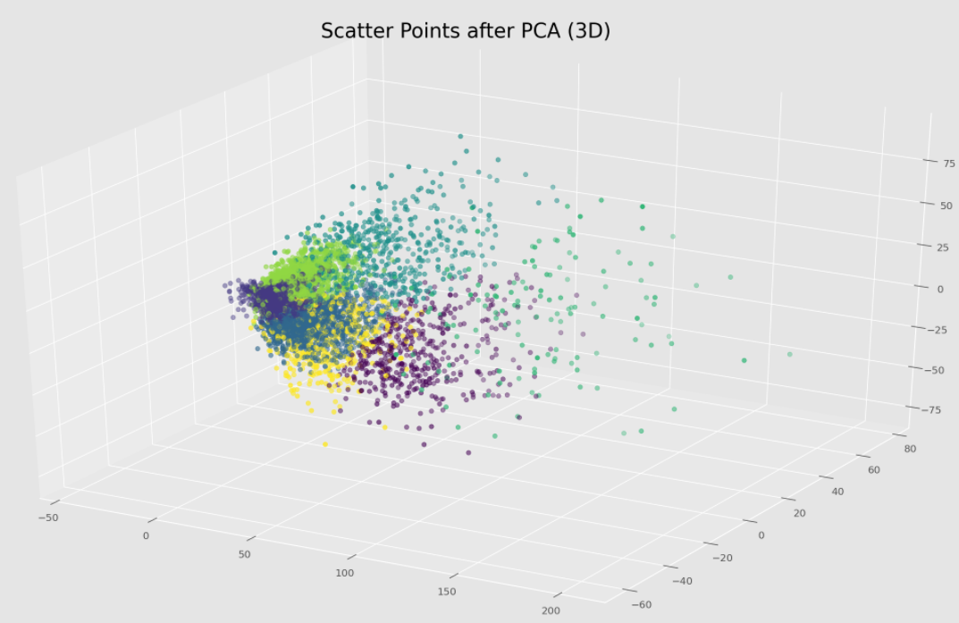

K-Means based recommendation System
Notes:
K-Means Algorithms
In the k-means model, we conduct PCA for feature selection and then used Elbow score to select the seven optimal clusters.
Then within each cluster the animes sorted by user_ratings
The final 10 recommendations will be pulled from the cluster based on target Anime rating upwards similarity

Slide 22

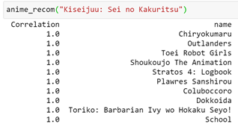
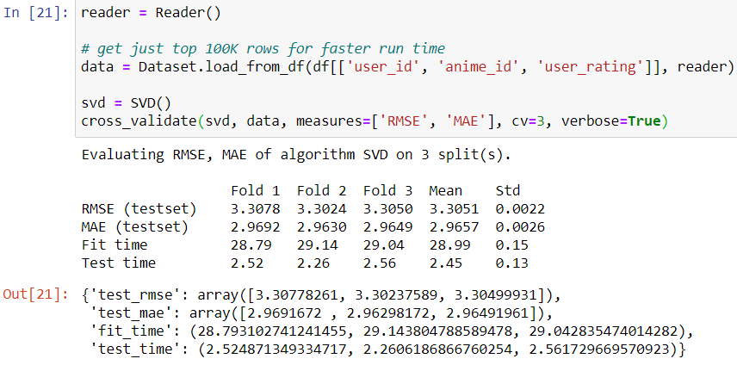
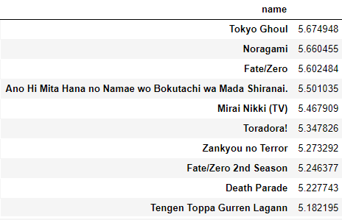
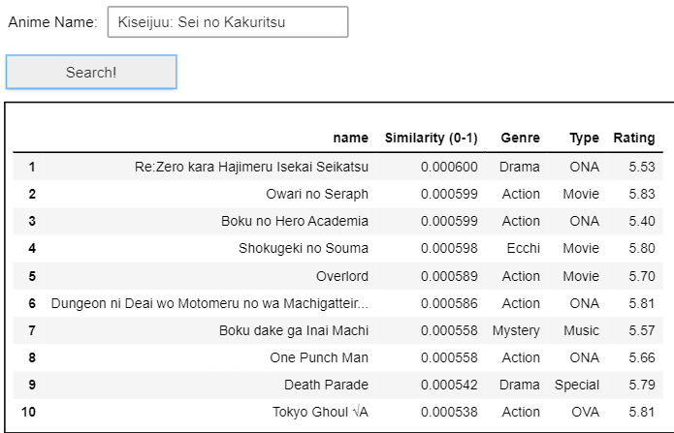
Top 10 related animes: Kiseijuu: Sei no Kakuritsu (Parasyte)
Pearson R
Unsupervised K-means
Unsupervised KNN
Evaluation of system
Notes:
K-Means Algorithms
In the k-means model, we conduct PCA for feature selection and then used Elbow score to select the six optimal clusters.
Then within each cluster the animes sorted by user_ratings
The final 10 recommendations will be pulled from the cluster based on target Anime rating upwards similarity

Slide 23
Risks and Uncertainties
The data used to build the models are samples selected from the full dataset
The data are collected from only one website
By using different algorithms, the recommendation results of the recommendation systems are very different
Evaluation of the performance of unsupervised model is difficult

Slide 24

Conclusions & Lessons Learned
Conclusion:
The MSE of prediction model is 2.03; the MAPE of prediction model is 17.58
The percentage error of the prediction model can be considered as below 20%
All recommendation models can provide a list of animes of potential interests for users
However, different algorithms give very different recommendation results
Lessons learned & next steps:
Differences between different supervised/unsupervised algorithms
Different evaluation methods for supervised and unsupervised algorithms
We may try find another package to evaluate the performance of unsupervised model

